Slide 1
Streaming Service User Analysis
Prashant Yadav_CDPA_B4

Slide 2

Introduction
The objective of this project is to analyze user behavior, preferences, and engagement on a streaming platform, identifying trends that can enhance user experience and guide business decisions. Using MS Excel, the analysis explores key metrics such as watch hours, subscription tiers, content preferences, device usage, and regional trends. By uncovering patterns across different user segments, the study provides insights to support personalized recommendations, improve retention, and drive strategic improvements.

Slide 3
Content
01 Data Modification
02 Subscription and Revenue Analysis
03 User Engagement Metrics
04 Demographic & Behavioral Insights
05 Retention and Loyalty
06 Payment Preferences and Regional Trends
07 Regional Content Trends
08 Recommendations and Conclusion

Slide 4
01 Data Modification

Slide 5
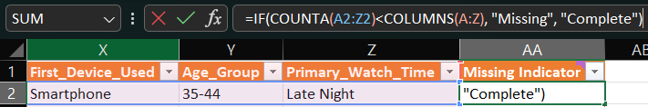
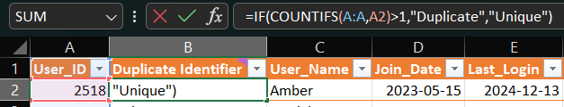
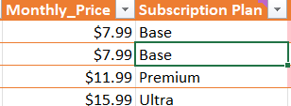
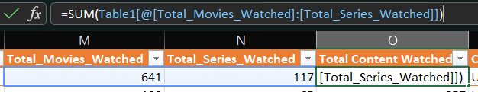
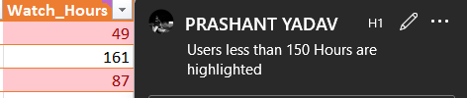
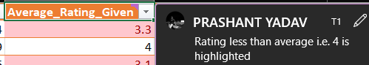
Key Changes
Checked Duplicates or Missing Data in the given database using Duplicate Identifier and Missing Data Identifier.
For better understanding and analysis of Monthly Price, added additional dataset which represents Monthly Price in a form of categorical data.
To find correlation between recommended content and total content watched, added additional column in which it shows total content watched by user which is movies and series combined.
Converted complete database into form of a table and applied proper formatting.
Additionally, highlighted cells with less watch hours and also highlighted rating below average

Slide 6
02 Subscription and Revenue Analysis

Slide 7
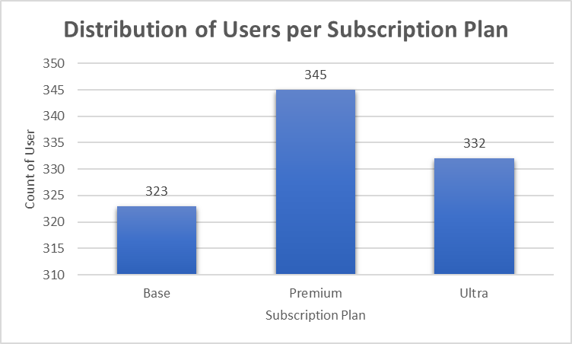
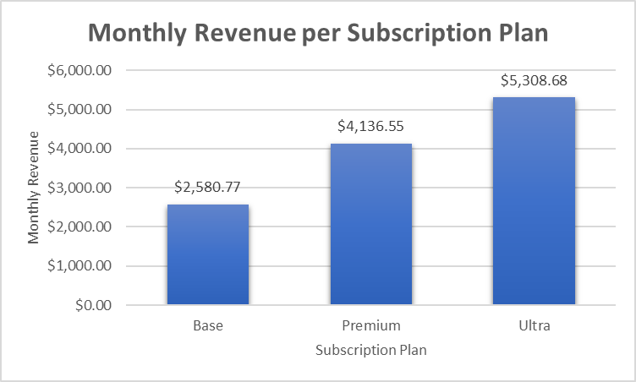
Revenue Insights
User Count by Subscription Tier was analyzed using a pivot table.
The distribution indicates varying adoption across Base, Premium, and Ultra plans, helping to understand which pricing tier is most popular.
This informs which plans contribute most to revenue and where promotions could be targeted.

Slide 8
03 User Engagement Metrics

Slide 9



User Engagement Metrics
Average Watch Hour Per User
Total Movies vs Series watched
Recommended Content
The average watch time per user is 254.5 hours, which is a strong engagement metric for the platform.
Total movies vs series watched per users is 5.172, which suggests more movie engagement.
Impact of recommended content on total content watched by user is having no relation.

Slide 10
04 Demographic & Behavioral Insights

Slide 11
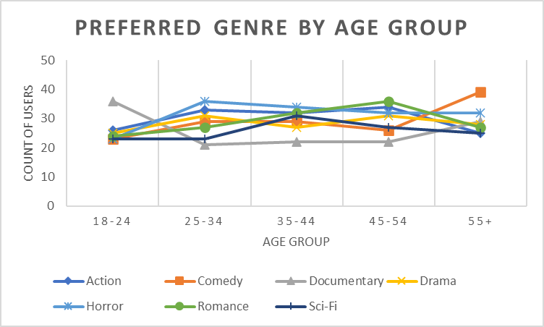
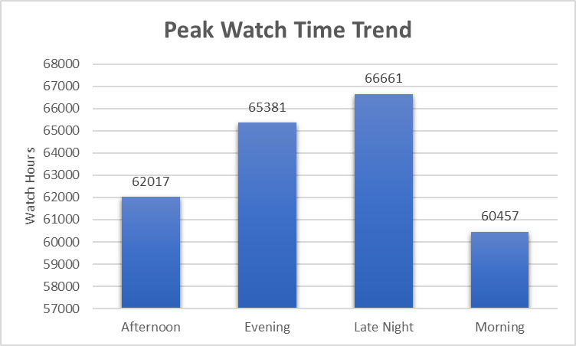
Demographic & Behavioral Preferences
Genre preference was analyzed across users. Most popular genres include Action, Comedy, Drama, Sci-Fi, and Horror.
This distribution helps content teams understand what genres to invest in for specific user bases.
For deeper insight, the genre data could also be cross-referenced with age group or watch time to identify high-value content clusters.

Slide 12
05 Retention and Loyalty

Slide 13
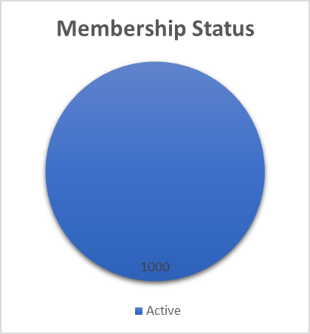
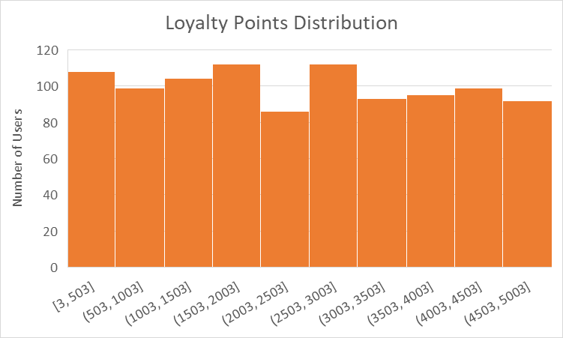
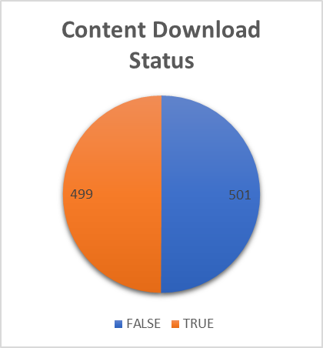
Retention & Loyalty
1,000 users have an Active Membership Status, indicating a healthy active user base.
Additional factors like loyalty points and download behavior could be linked to user retention likelihood.

Slide 14
06 Payment Preferences and Regional Trends

Slide 15
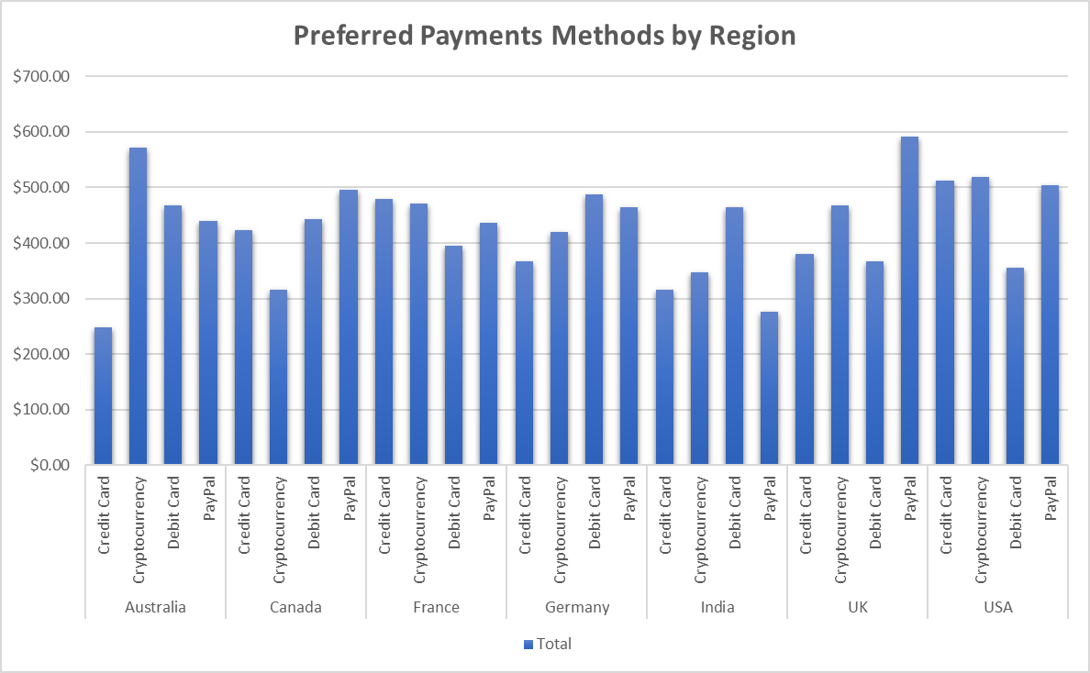
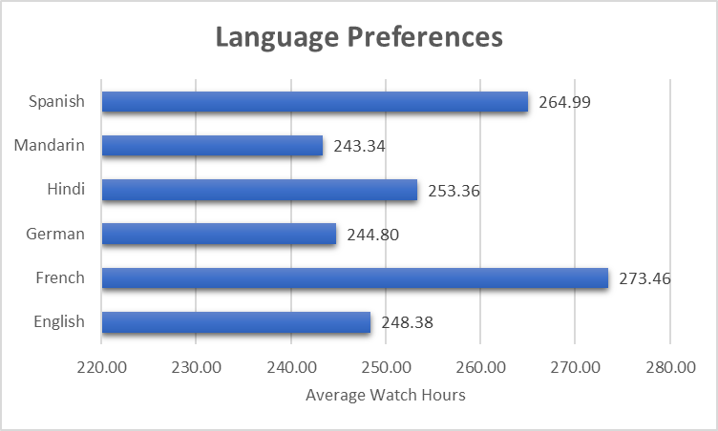
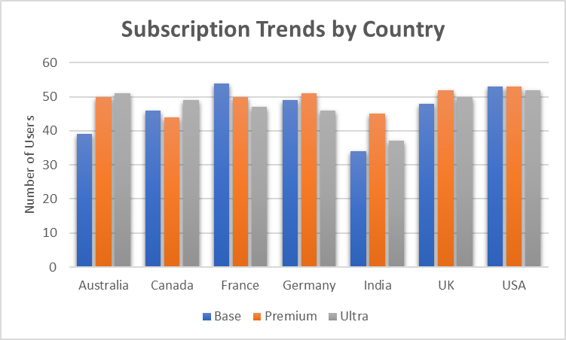
Regional & Payment Trends
Countries like Australia and Canada show significant contributions to revenue (e.g., Australia: $1726.60).
Subscription preference by country reveals which regions prefer Base vs. Premium plans, helping tailor local pricing strategies.
English-language users have an average watch hour of ~248.4 hours, indicating strong engagement among English-preferring users.

Slide 16
07 Regional Content Trends

Slide 17
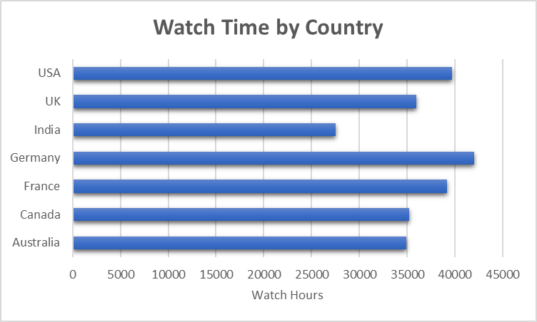
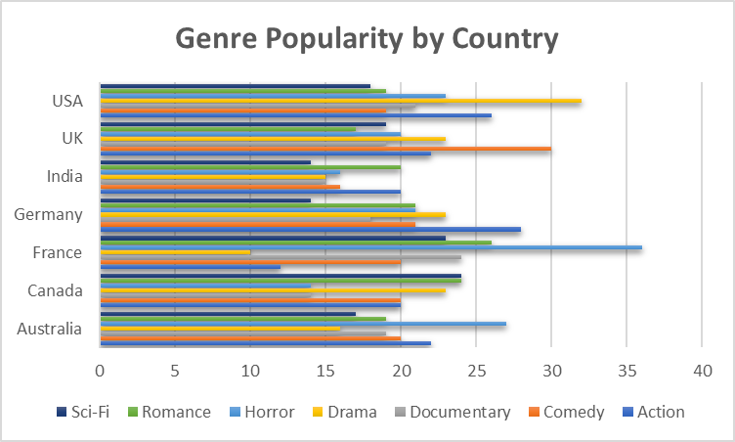
Regional Content Trends
Genre preferences differ by region:
Australia prefers Horror and Action.
Canada leans toward Drama and Sci-Fi.
Understanding regional tastes allows the platform to personalize content libraries and drive engagement through relevant recommendations.

Slide 18
08 Recommendation and Conclusion

Slide 19

Key Highlights
Strong User Engagement
Average watch time per user is ~254.5 hours, indicating highly engaged users.
Popular Content Genres
Top genres include Action, Comedy, Drama, Sci-Fi, and Horror.
These preferences vary by region, suggesting potential for localized content strategies.
Active Membership Base
Platform maintains 1,000 active users, reflecting stable retention.
Regional Revenue Contribution
Australia and Canada contribute significantly to revenue.
Australia alone accounts for $1726.6 in monthly subscription revenue.
Language and Engagement Link
English-preference users show high engagement with ~248.4 average watch hours.

Slide 20

Recommendations
Invest in Popular Genres
Increase content acquisition/production in top-performing genres (e.g., Action, Drama, Sci-Fi).
Localize Content by Region
Tailor recommendations and featured content by regional genre preferences (e.g., Horror in Australia, Drama in Canada).
Strengthen Retention Strategy
Introduce personalized offers or loyalty rewards for users nearing cancellation risk (e.g., low watch hours or recent joiners).
Promote High Engagement Features
Encourage content downloads and profile sharing, as these behaviors may link with higher engagement and loyalty.
Optimize Language Options
Expand multi-language support or subtitles to enhance engagement among non-English users.

Slide 21
conclusion
The analysis reveals a healthy user base with strong content engagement, especially among English-language and premium-tier users. By leveraging insights on genre, regional behavior, and platform usage patterns, the streaming service can fine-tune its content, pricing, and retention strategies to boost satisfaction and long-term growth.

Slide 22
Thank you

